Slide 1
The next slide is a possible vision for the active page

Slide 2
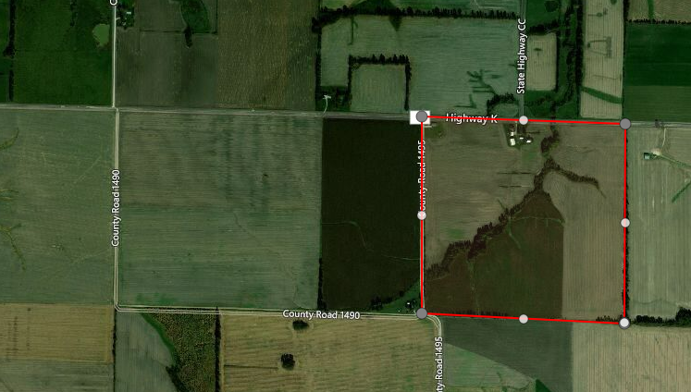
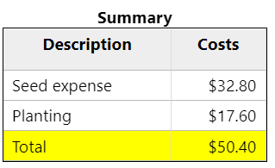
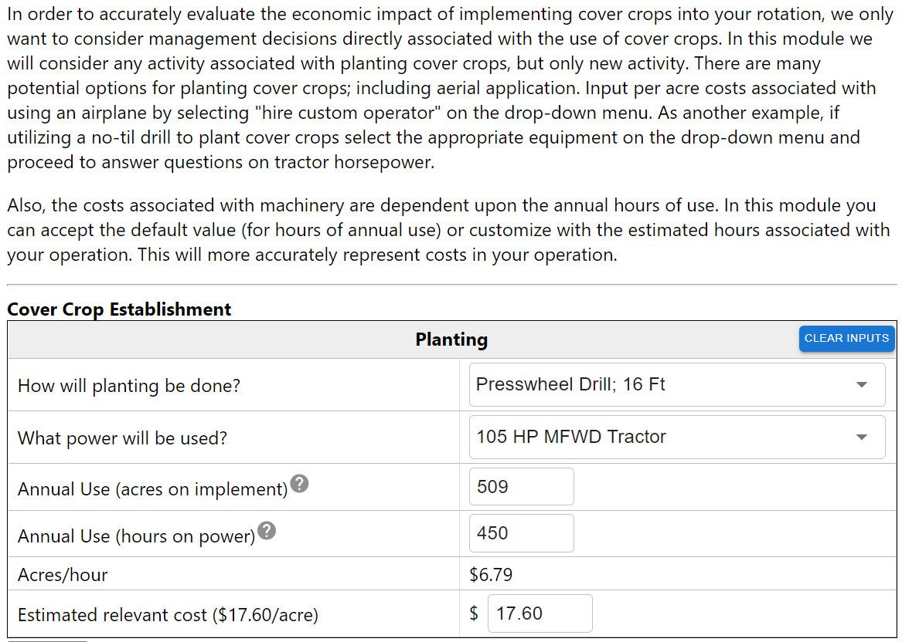
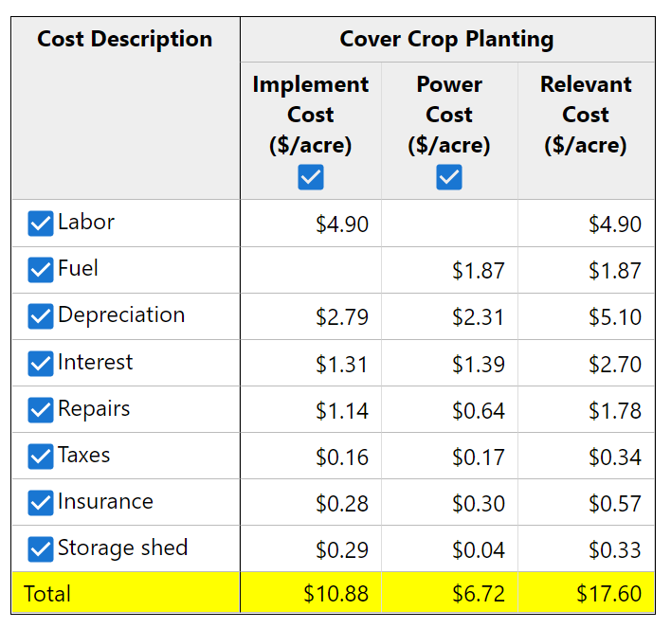
Cover Crop Decision Support Tool
Field & Farm
Cover Crop Selection
Seedbed Preparation
Planting Decisions
Termination
Tillage
Fertility
Herbicide
Soil Erosion Control
Other
Back: Seedbed Preparation
Next: Termination
Resources

Slide 3
The next page is a possible vision of the Results page

Slide 4

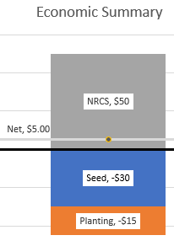
Cover Crop Decision Support Tool
Field & Farm
Cover Crop Selection
Seedbed Preparation
Planting Decisions
Termination
Tillage
Fertility
Herbicide
Soil Erosion Control
Other
Seed

